Slide 1


Introduction Applications for MODIS (and VIIRS)
Perry Oddo <perry.oddo@nasa.gov
15 November, 2022

Slide 2
Objectives
Understand the technical capabilities of the MODIS (VIIRS) instruments
Explore some of the common applications for MODIS data
Download some data with interactive Python script
Adapt script for your own applications

Slide 3
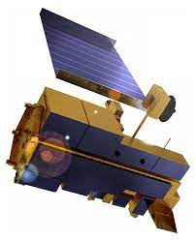
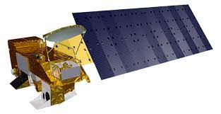
What is MODIS?
Moderate Resolution Imaging Spectroradiometer
One of the primary instruments aboard Terra and Aqua satellites
Launched in 1999/2002
Satellite revisit time: 1-2 days
Terra = North → South in the morning
Aqua = South → North in the afternoon
Acquires 36 spectral bands
Spatial resolution: 250-5,600 meters
Terra
Aqua

Slide 4
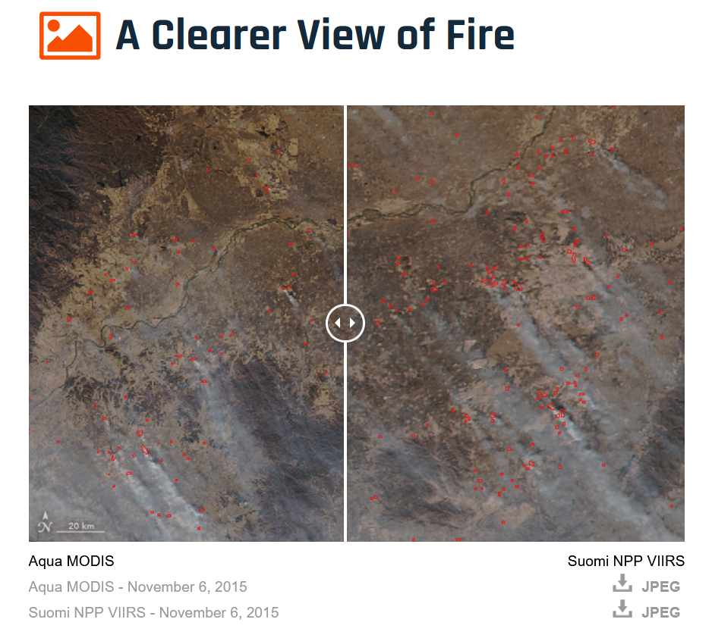
What is VIIRS?
Visible Infrared Imaging Radiometer Suite
One of the primary instruments aboard Suomi NPP and NOAA-20 weather satellite
Launched in 2011
Second-gen moderate-resolution radiometer
Continues MODIS record
Fewer bands (22) but improves resolution: “A Clearer View of Fire” - December 8, 2015

Slide 5
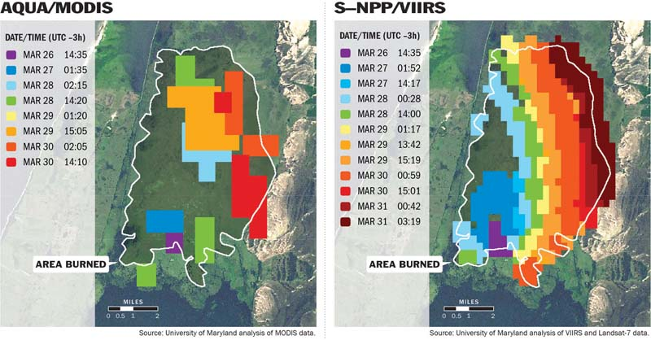
MODIS vs. VIIRS: Spectral Bands
Source:
https://wildfiretoday.com/2013/11/14/better-satellite-imagery-enables-improved-wildfire-mapping-and-growth-predictions/
Notes:
Falls Fire, California, USA

Slide 6
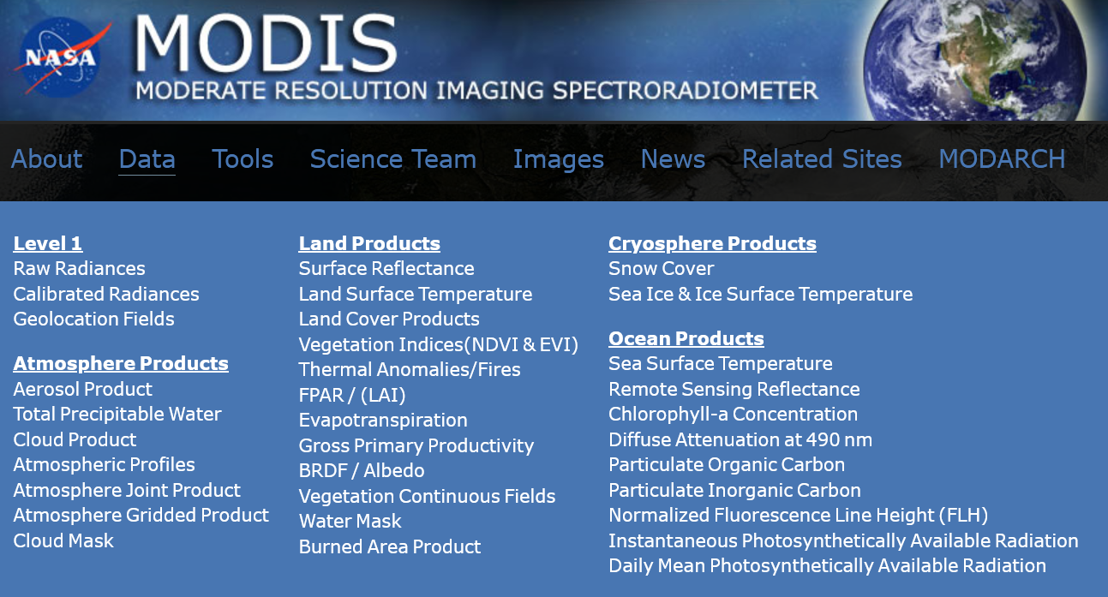
What products are available?
The MODIS Product table shows available products for different application areas: https://modis.gsfc.nasa.gov/data/dataprod/

Slide 7
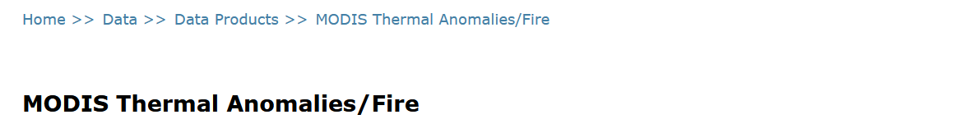
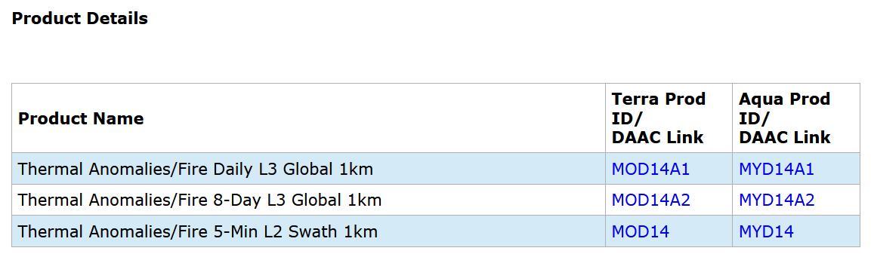
Exploring the data
Example dataset: Thermal Anomalies/Fire
Full product name
Short name

Slide 8
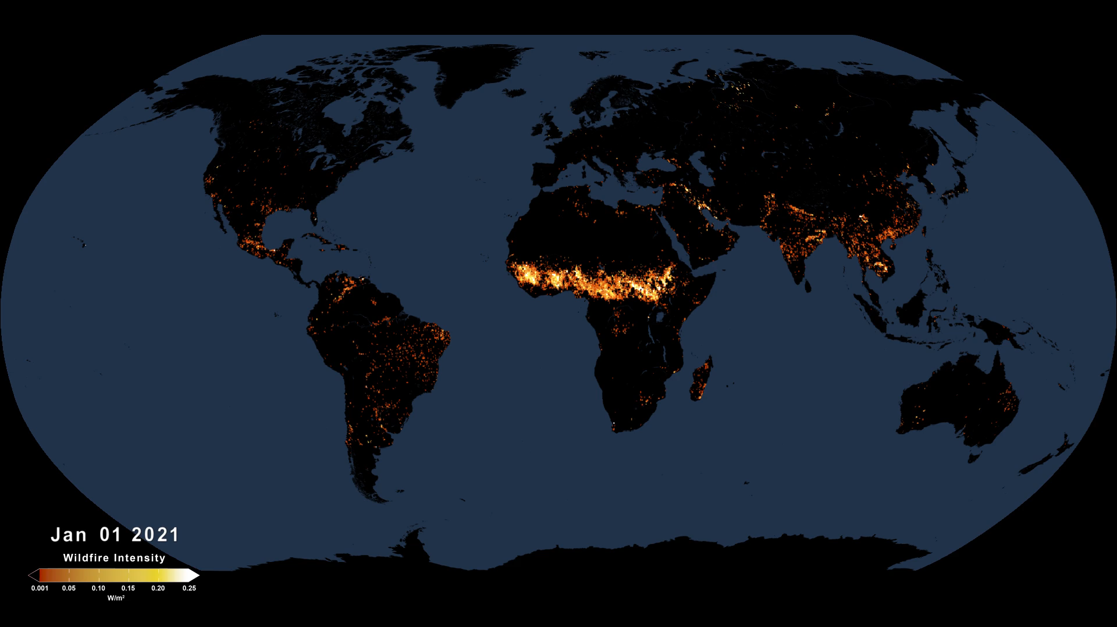
Visualizing the data
Notes:
Active Fires As Observed by VIIRS, January-September 2021
Source: https://svs.gsfc.nasa.gov/4945

Slide 9
Near Real-Time (NRT) Capabilities
At mid-latitudes MODIS/VIIRS can image surface of the Earth twice daily
This makes these sensors suitable for NRT applications:
near real-time
adj
“Data products are generated and especially useful for users whose primary interest is the low latency for data availability. While standard data products are available within a few days of observation, NRT data products are usually available within 3 hours of observation”

Slide 10
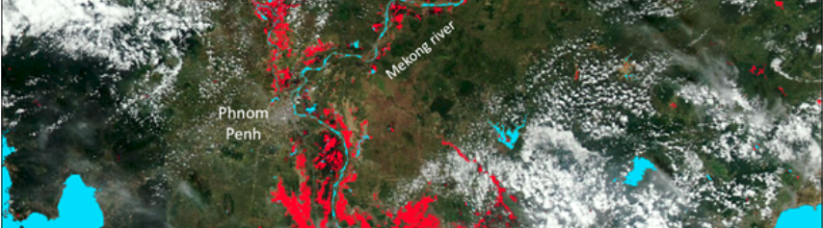
NASA LANCE: Near Real-Time Data and Imagery
NASA's Land, Atmosphere Near real-time Capability for EOS (LANCE): https://www.earthdata.nasa.gov/learn/find-data/near-real-time
Example:
NRT Global Flood Product: https://www.earthdata.nasa.gov/learn/find-data/near-real-time/modis-nrt-global-flood-product
250-m surface water map

Slide 11
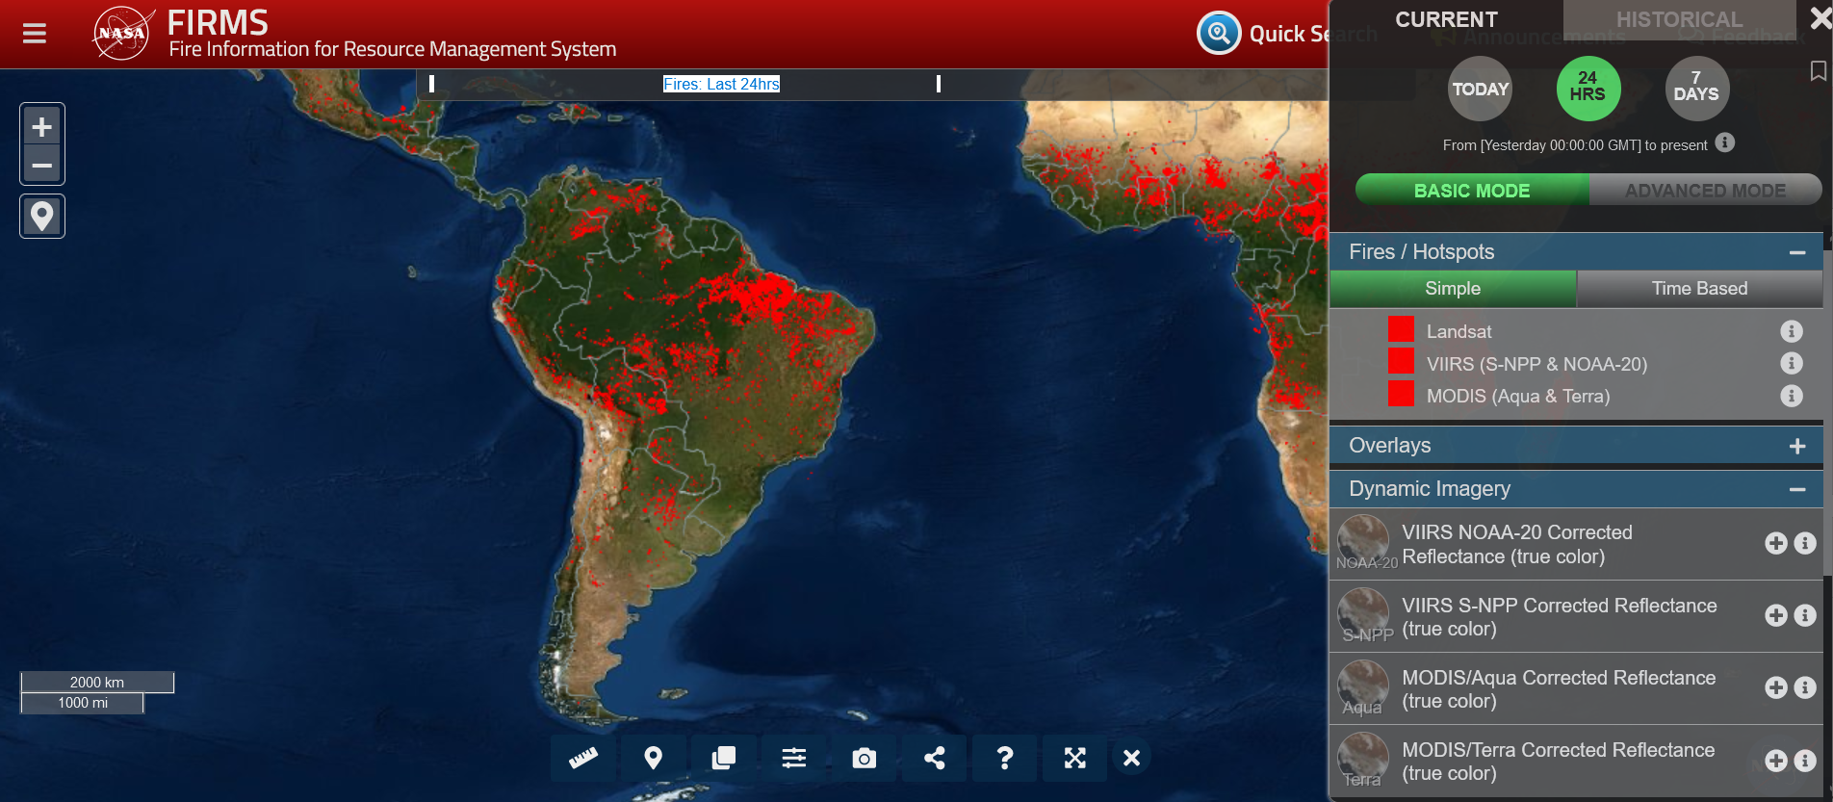
NASA LANCE: Near Real-Time Data and Imagery
Example:
Fire Information for Resource Management System (FIRMS) https://www.earthdata.nasa.gov/learn/find-data/near-real-time/firms
MODIS & VIIRS active fires / thermal hotspot

Slide 12
MODIS/VIIRS Access and Analysis: Exercises

Slide 13
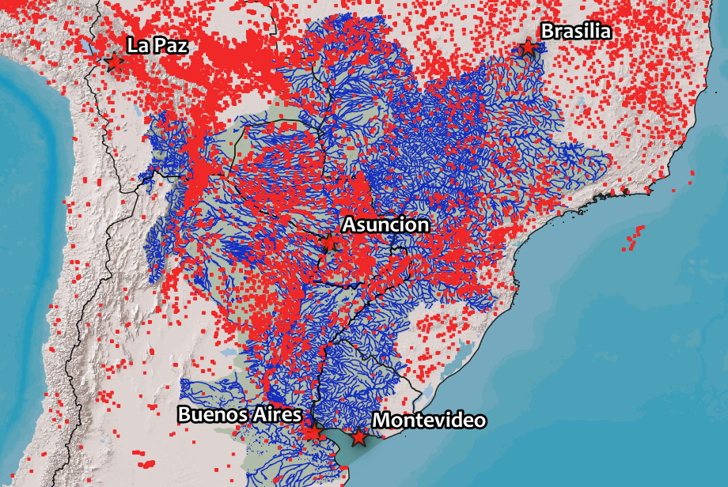
Exercise 1: Import VIIRS fire data into QGIS
First, you will need to request a free web map key:
https://firms.modaps.eosdis.nasa.gov/mapserver/wms-info/#firms-mapkey
Then, follow tutorial on FIRMS website:
https://firms.modaps.eosdis.nasa.gov/ tutorials/qgis/

Slide 14
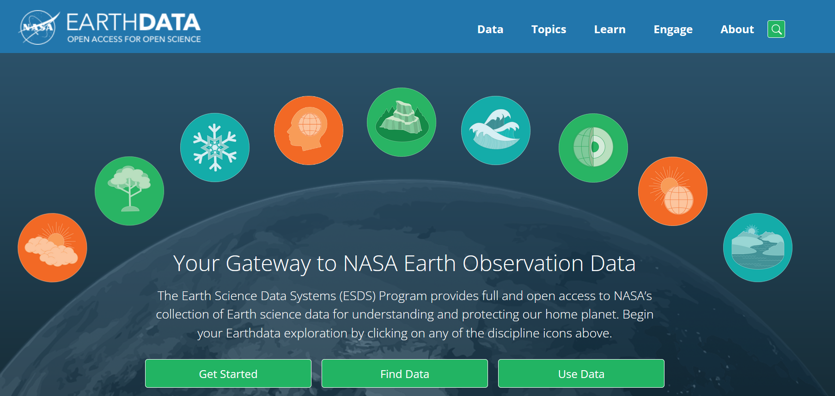
Exercise 2: Access and Analyze MODIS NDVI with Python
We will use a tool called Jupyter Notebooks to interactively explore the data
You will need to register for an account for NASA’s Earthdata Platform: https://urs.earthdata.nasa.gov/
Earthdata
Management system for users getting Earth science data from any of the Distributed Active Archive Centers (DAACs)

